Slide 1

InsightForge AI
Automated Data Analysis System
InsightForge
PRESENTED BY
Manthan Jadav

Slide 2

Transforming Data into Actionable Insights
INSIGHTFORGE AI ENABLES AUTOMATED ANALYSIS
Effortlessly convert raw data into insights.

Slide 3

Challenges of Traditional EDA
Traditional exploratory data analysis is often time-consuming and complex, posing significant hurdles for newcomers and experts alike.

Slide 4

The Preprocessing Time Drain in Data Analysis
UNDERSTANDING THE IMPACT OF PREPROCESSING
60-70% of time is spent on data preprocessing.

Slide 5
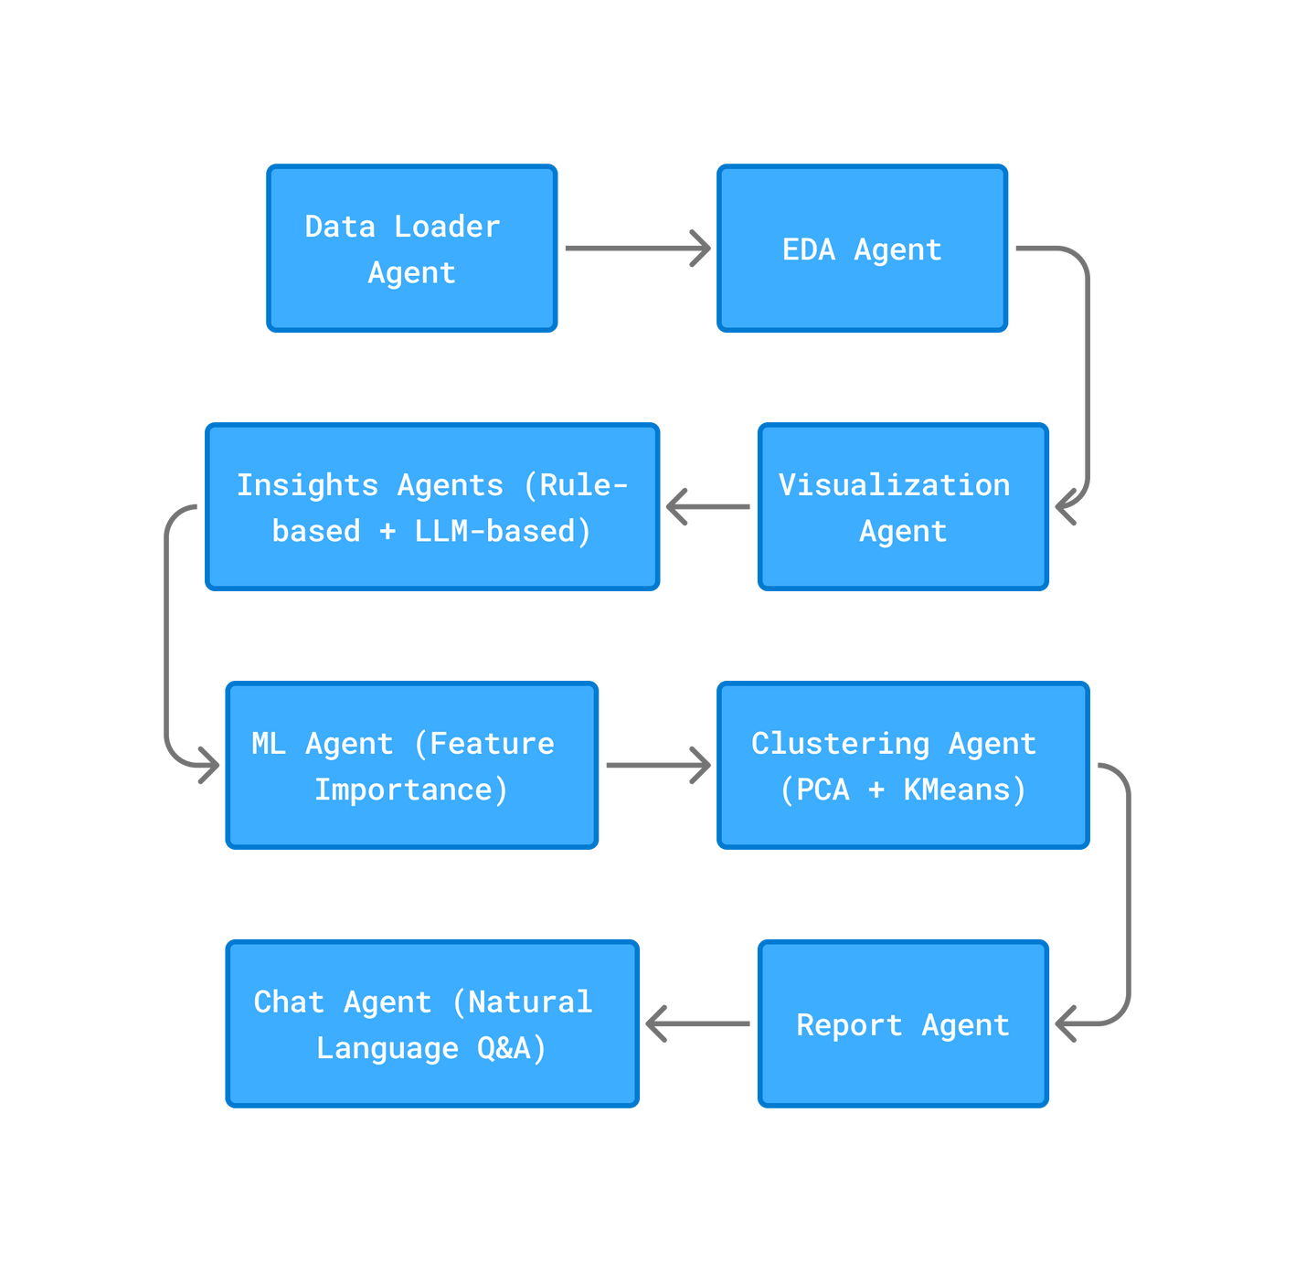
Multi-Agent Architecture
This diagram illustrates how specialized agents collaborate within InsightForge AI to streamline exploratory data analysis and reporting processes seamlessly.
Visual representation of agent interactions within the system.

Slide 6

AI-Powered Insights
AUTOMATED WORKFLOWS
Streamlined processes enable quick data insights.
INSIGHT EXTRACTION
AI identifies patterns and highlights trends automatically.
USER-FRIENDLY INTERFACE
Simplified interaction promotes ease of data exploration.

Slide 7

Interactive Data Visualizations
ENHANCED USER ENGAGEMENT
Users can explore data with dynamic visual tools.
REAL-TIME UPDATES
Insights change instantly with new data inputs.
USER-FRIENDLY INTERFACE
Intuitive design promotes easy data navigation.

Slide 8
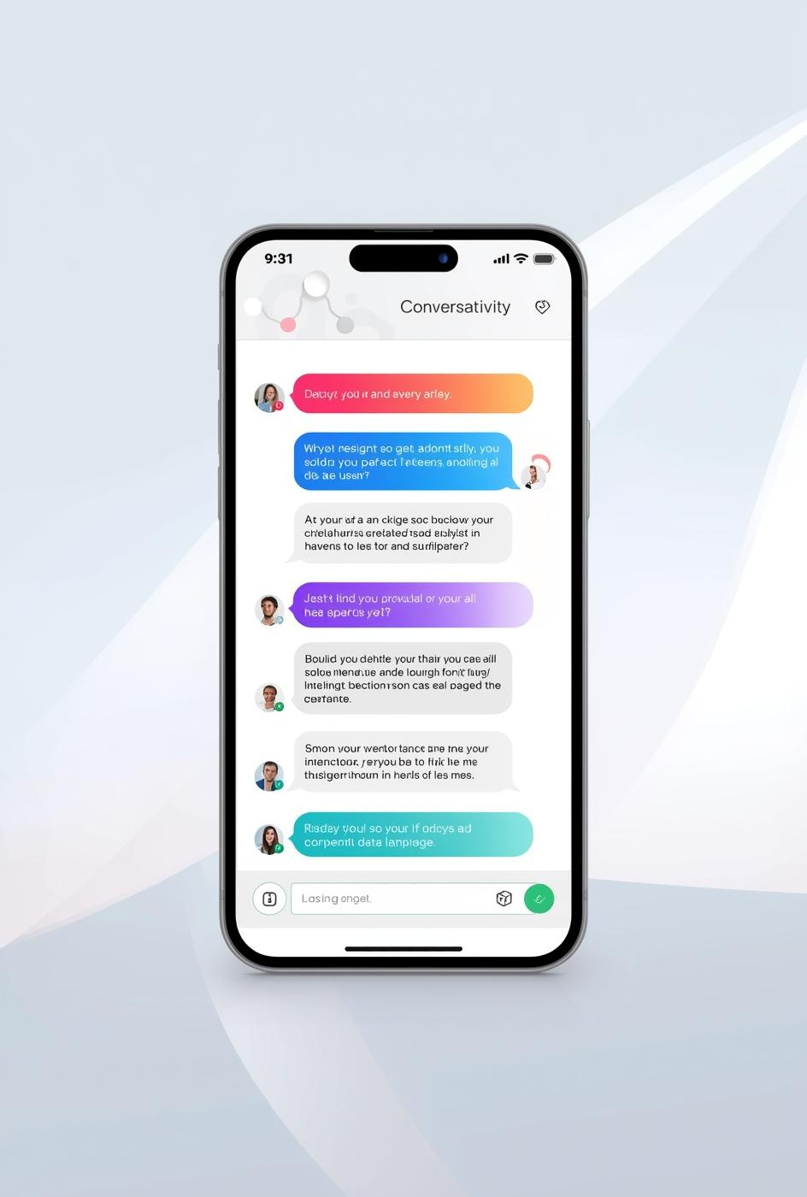
LLM-Based Chat Interface
INTUITIVE DATA QUERIES
Users can ask questions naturally and receive insights.
CONVERSATIONAL INTERACTION
Engage with data analysis through a chat interface.
USER-FRIENDLY EXPERIENCE
Simplifies complex data queries for everyone involved.

Slide 9

Real-World Applications
InsightForge AI accelerates data analysis, enabling faster decision-making and empowering teams to leverage insights effectively.

Slide 10

Advantages of Automation in Data Analysis
REDUCED MANUAL EFFORT FOR ANALYSTS
Automation significantly cuts down on time-consuming tasks, allowing analysts to focus on strategic insights.

Slide 11

Case Study: Rapid Insights
A business analyst uploads a sales dataset and receives actionable insights in just 20 seconds, enhancing decision-making efficiency.

Slide 12

Student Project Exploration
InsightForge AI enables students to easily analyze datasets, enhancing their project work with quick insights and data-driven decisions.

Slide 13
Key Points
ARCHITECTURE
Multi-agent design enhances efficiency and scalability.
INSIGHTS
AI-powered analysis delivers actionable outcomes swiftly.
AUTOMATION
Reduces manual effort, empowering non-experts effectively.

Slide 14
Future Enhancements
AUTO ENGINEERING
Automatically derive features for improved model performance.
MULTI-DATASET
Compare multiple datasets seamlessly for comprehensive insights.
API DEPLOYMENT
Deploy as an API for easy integration and access.

Slide 15

Thank You
EMAIL
hello@reallygreatsite.com
SOCIAL MEDIA
@reallygreatsite
PHONE
123-456-7890

